Slide 1

Biodiversity analysis Final Project: Data Science Foundations
Bruno motta

Slide 2

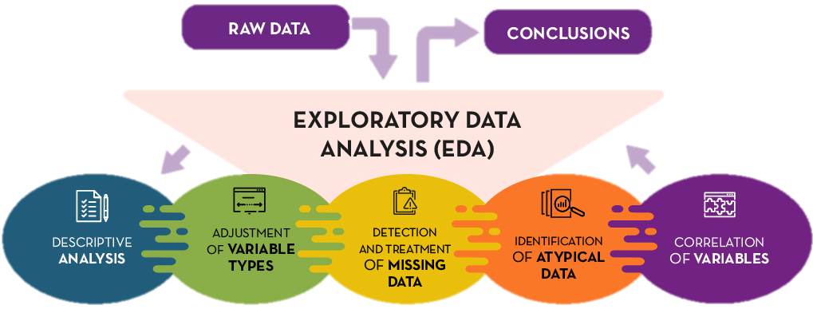
Summary
Project Scope
Code Preparation
Data Understanding
Data Preparation
Data Analysis
Conclusion

Slide 3
PROJECT SCOPE
These datasets were made available by Codecamy as part of the final project for the Data Science Foundations Course, a complete course on all the basic knowledge necessary to become a Data Scientist, and introductory to the complete career paths for different Data Scientist’s fields of activity.
The project’s main objective is to make a complete Exploratory Data Analysis (EDA) over 2 datasets that represent the biodiversity in 4 different parks in the US and the conservation status, in terms of the endangerment, of each observed species.
Some of the insights that we’ll be looking for are:
What is the distribution of conservation status for animals?
Are certain types of species more likely to be endangered?
Are the differences between species and their conservation status significant?
Which species were spotted the most at each park?
Among others…

Slide 4
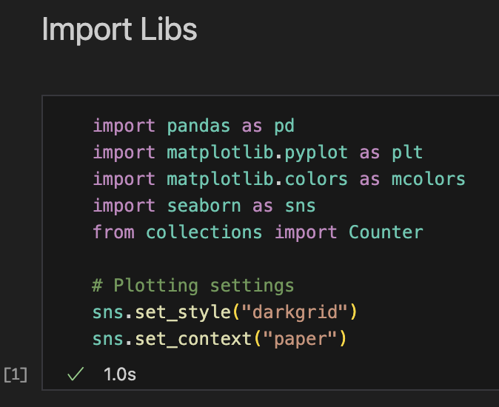
Code preparation
In order to be able to perform the EDA, we need to kickstart the Python code importing the necessary libraries. In this case, we are going to use mainly Pandas, Matplotlib and Seaborn. I have also set some Seaborn’s configurations, to standardize the plots.

Slide 5
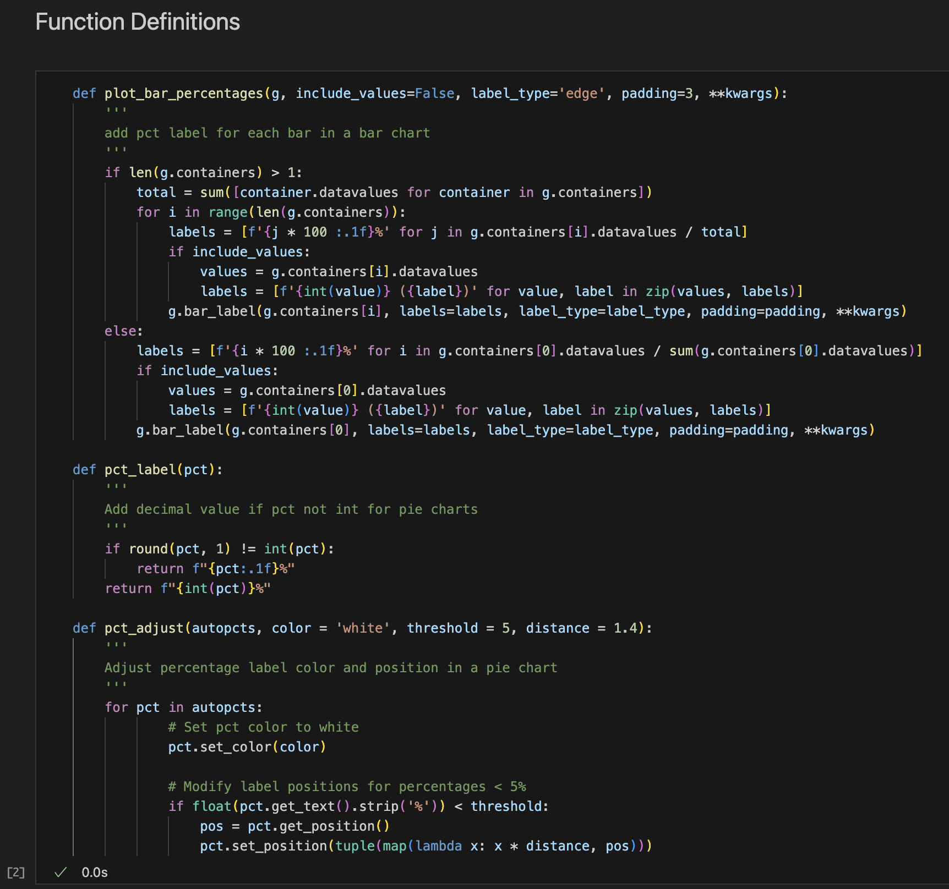
Code preparation
I like to organize my notebooks (.ipynb) placing the Functions and Classes definitions at the top of the code, right after the libs. Normally they are not defined at the beginning of the analysis, because we don’t know yet which functions we’ll need to create down the road. But as soon as I need to create a new function or Class, I place it at the top.
For this project, I created 3 functions, all of them to standardize the plots along the analysis. The first one was to add percentages and values to bar charts.

Slide 6
Code preparation
The second function decides if the percentage label of the pie chart will have a decimal point or not, depending if it’s an integer or not. And the last function adjusts this label’s color and position.
It’s important to create new functions every time we are repeating some part of the code that was already used before. This way we avoid long codes that are essentially doing the same thing several times.

Slide 7
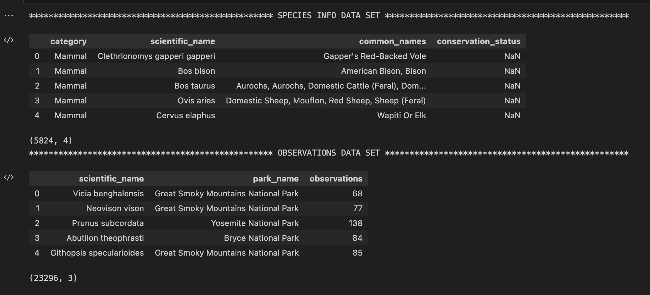
Data understanding
The first, and maybe the most important, step of the analysis is to understand the data that we are going to work with. That means, to visualize the first rows of each data set and understand the information we have there.

Slide 8
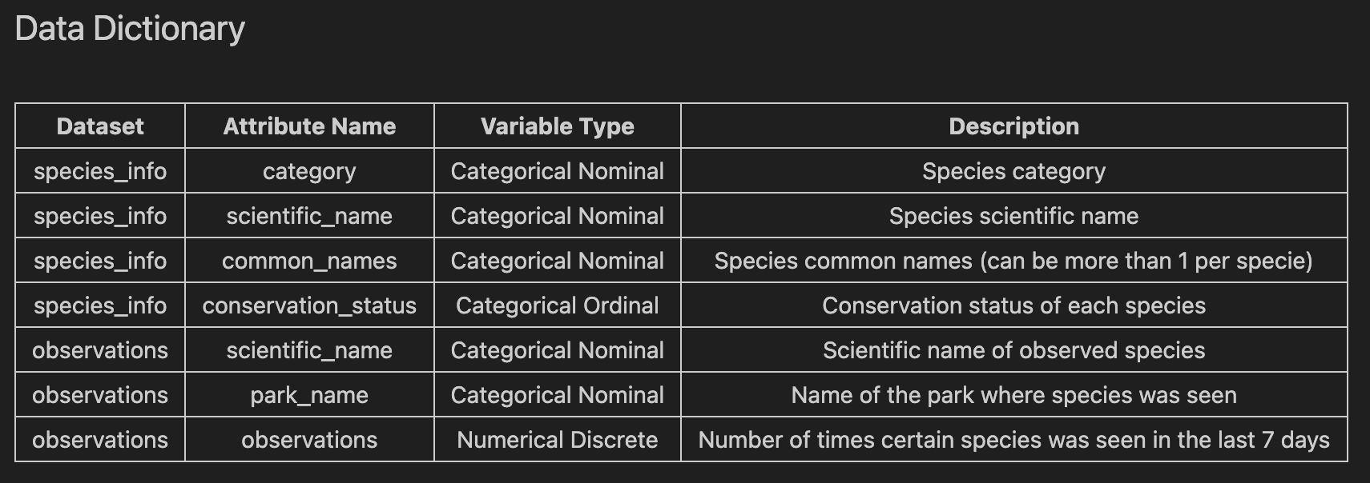
Data understanding
One important step, that most of the time we take for granted, is to build a data dictionary, where we describe each variable of the data set.

Slide 9
Data preparation
Also known as Data Wrangling and Tyding, this step is where we check the data set for missing values, duplicated rows, and any other cleaning or organization that we might need to do in order to make them ready to be used in our analysis.
In our case, it was necessary to input missing values in the conservation status column, where the species not classified as in danger were blank, so I filled those values with “Unclassified”. Then, I create a new column to identify if the species was protected (considered in danger) or not, this will be useful later on in the analysis. And finally, I created a copy of the species_info dataset to clean it in order to have one row for each unique species, this copy was used to create 2 new data frames that will be used later on: “classified” and “merge”.

Slide 10
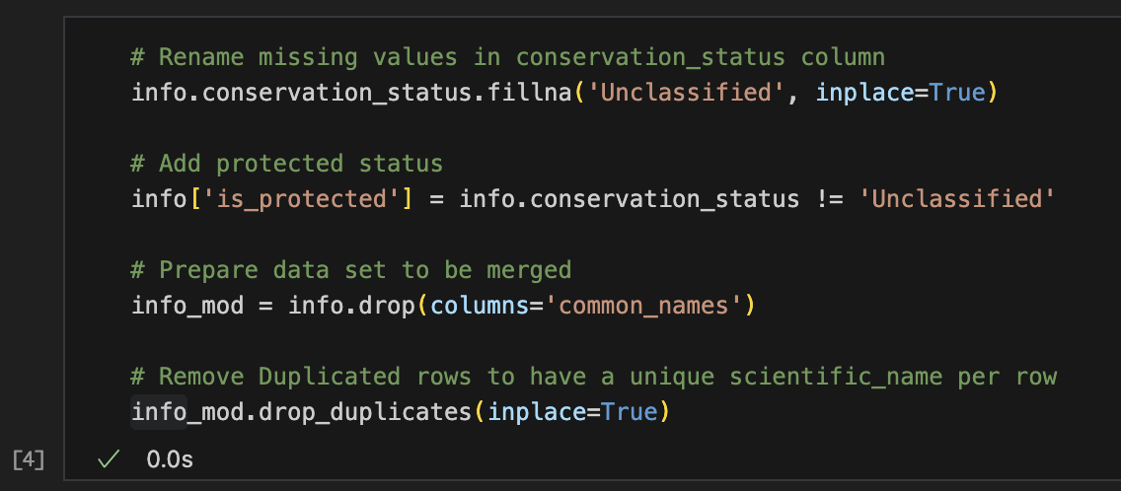
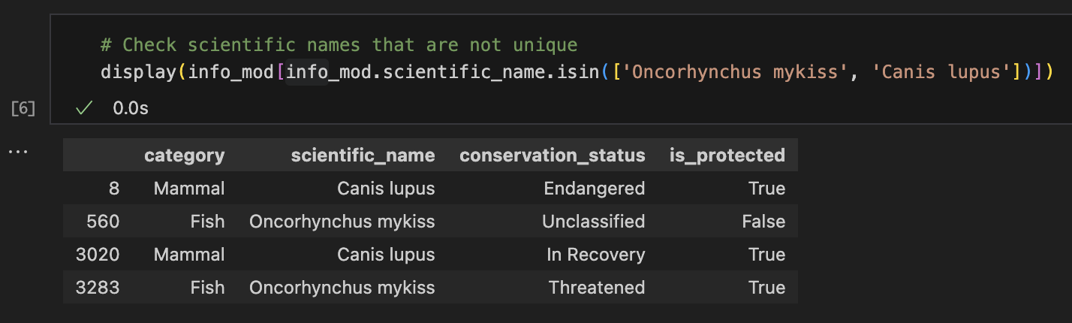
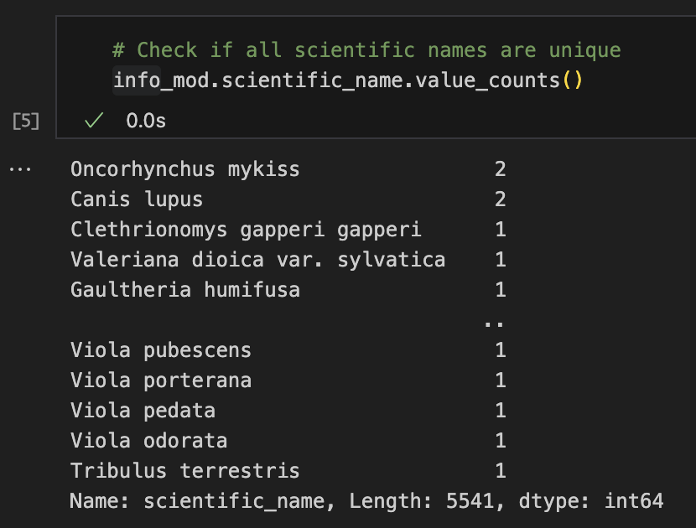
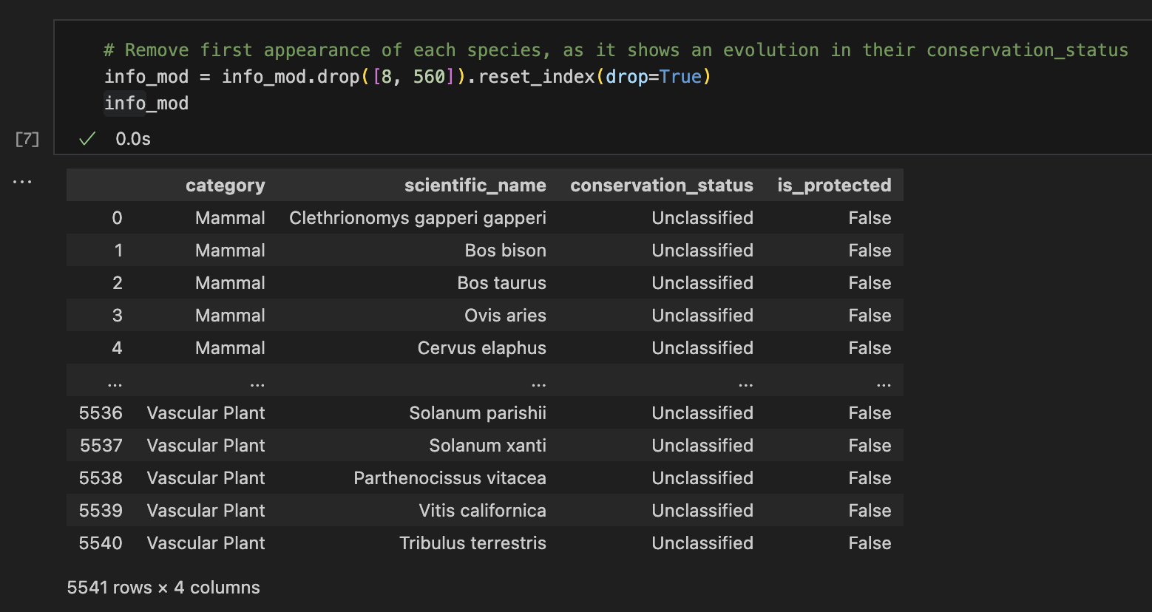
Data preparation

Slide 11
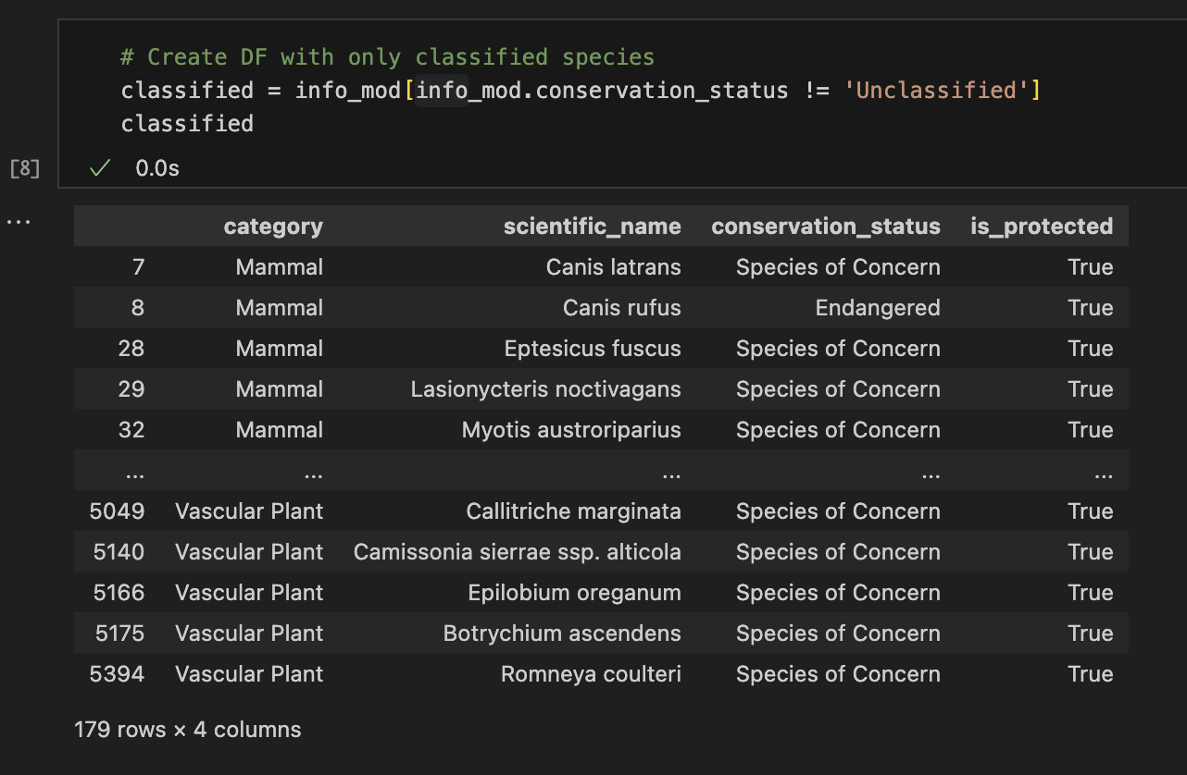
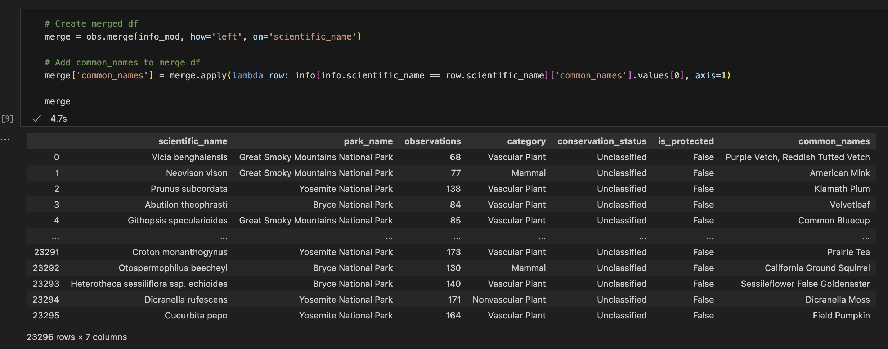
Data preparation

Slide 12
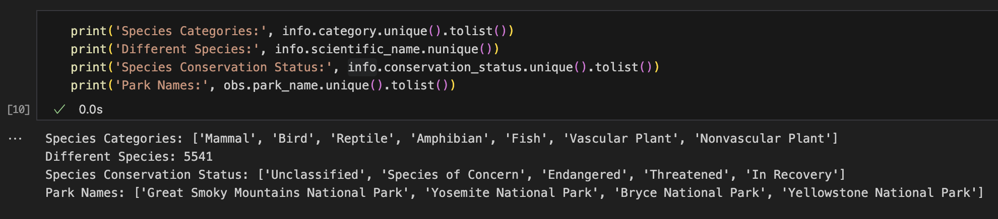
Data analysis
After all the understanding and preparation, here is where we finally start to properly analyze the data. This will be done mostly with the help of different charts, in which we will be looking for all the information that each variable can give us, by itself or grouped with others. The main goal of the data analysis is to find insights hidden in the data, answer the questions we have asked during the scope definition and find new questions to be answered while we are working on it.
To begin with, let’s take a look at each variable and understand which are the main categories that we have in both data sets.
Here we can see that we have 5541 different species, divided into 7 categories, classified into 5 conservation statuses and observed in 4 different parks. Let’s plot some charts to dive deeper into those pieces of information.

Slide 13
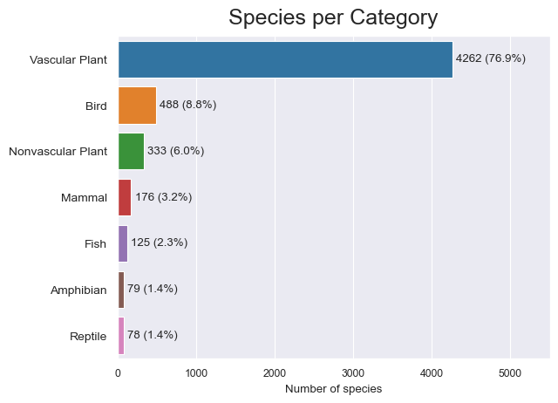
Data analysis
Ideally, we start with univariate analysis, where we look into each variable independently to extract all the information they can give us alone. Here we can see the distribution of species per category in the species_info data set, where it’s notable that a huge portion of the information that we have are about different species of Vascular Plants, totalizing more than three-quarters of the data.

Slide 14
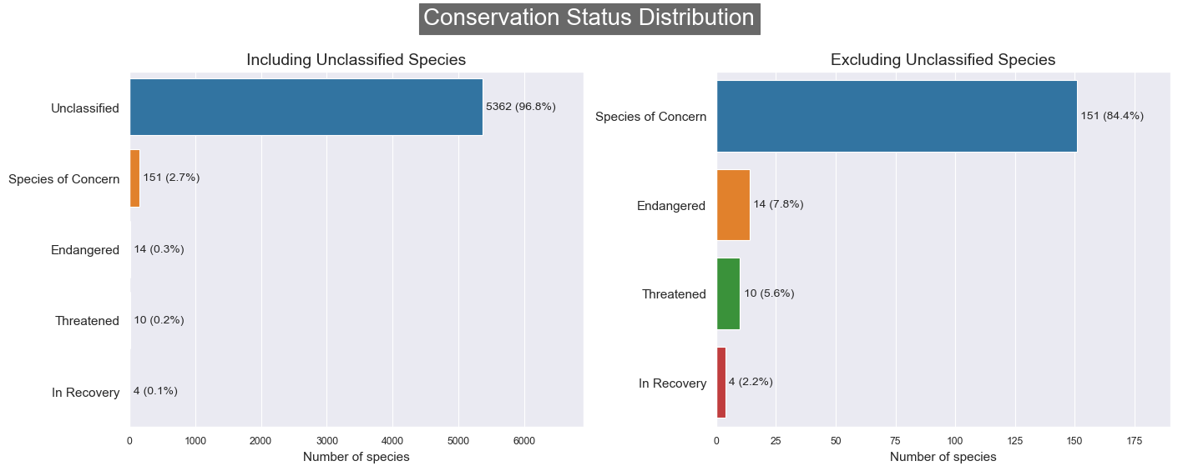
Data analysis
In the following charts, I plotted the distribution of species per conservation status. Since almost 97% of the observed species are not considered in danger, as we can see in the first chart, I plotted the second chart excluding those species, to have a better understanding of the distribution of the protected species. Over the 5541 species observed in this study, we have 14 classified as Endangered and 10 as Threatened, which are the most endangered categories in the data set. We can also observe that 4 species are In Recovery, which is good but could be better, and 151 (2.7% of the total data) are species of Concern.

Slide 15
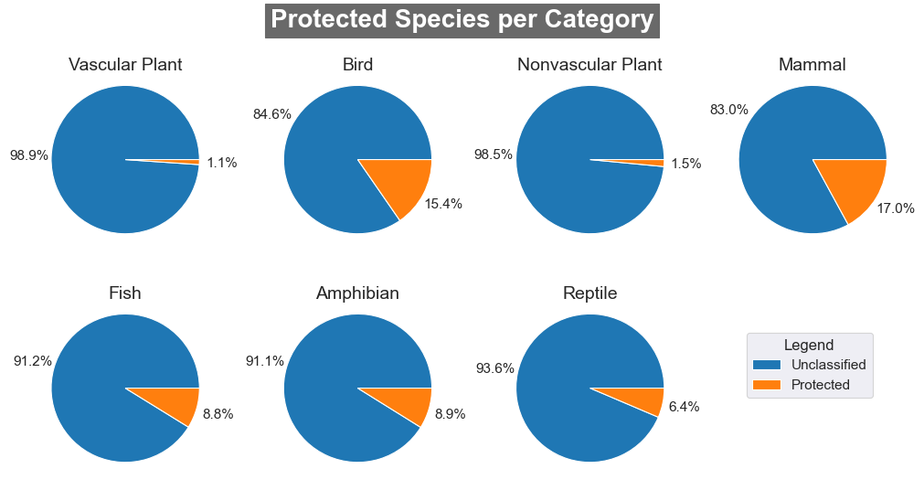
Data analysis
After finding that “only” 3.2% of our data set are species classified as endangered/protected, which is good because the lower this number, the better. I was faced with the first question that came to my mind in the middle of the analysis: What is the distribution of protected species per category?
That’s why I plotted the following pie charts and discovered that birds and mammals have the highest proportion of endangered species, both crossing the 15% mark. This is way higher than the 3.2% of the total data set, which we can see is biased by the high quantity of Vascular Plants and its lowest proportion of endangered species.

Slide 16
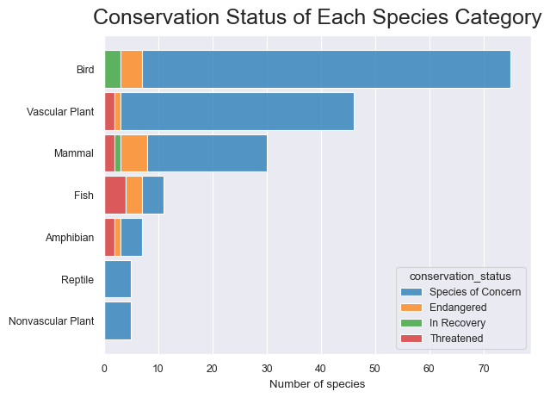
Data analysis
Going deeper into the understanding of protected species per category, I plotted the distribution of protection statuses of each category, to understand how each category is affected individually and in comparison with the others. Here we can see that birds have the highest quantity of species in danger, but also the highest number of species in recovery, and fishes are the ones with the highest number of species threatened, while reptiles and nonvascular plants have just a few species under concern.

Slide 17
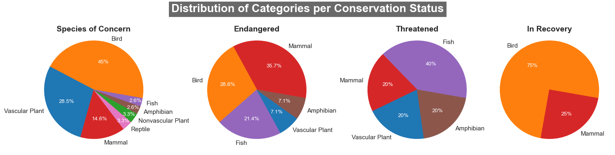
Data analysis
Another way of analyzing this information is by comparing the distribution of categories in each protection status, done with the 4 pie charts below. Here we confirm that birds appear with high proportions among almost all statuses, with the exception of the threatened one (at least), but one insight that we haven’t seen before is that mammals appear with a high proportion in all 3 alarming categories and only 1 of its species is in recovery. Also, fishes represent a high proportion of endangered and especially threatened species, but no single one is in recovery.

Slide 18
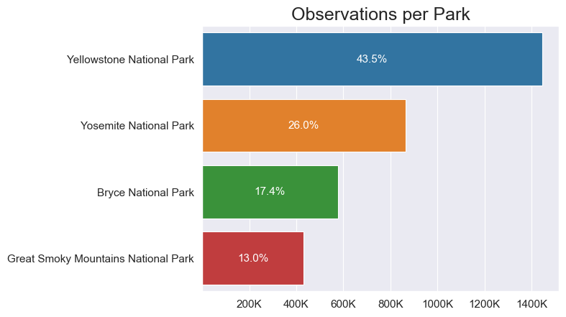
Data analysis
Here we start to look at the second data frame, where we can begin to analyze where each species were observed and how many of them have been spotted lately. First, let’s see the distribution of observations reported in the data set. We can see that the observations are not evenly distributed, with Yellowstone National Park showing roughly one million more reported observations than the Great Smoky Mountains National Park. But how is the distribution of species observed per park?

Slide 19
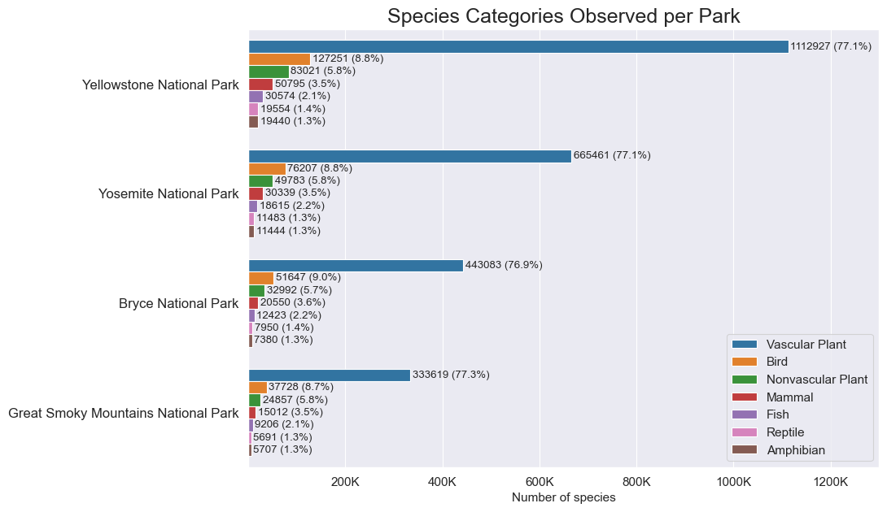
Data analysis
The distribution of species categories observed per park is almost perfectly even, where we can see almost the same proportions of each category per park. Showing that their biodiversity is very similar, despite the difference in the number of observations.

Slide 20
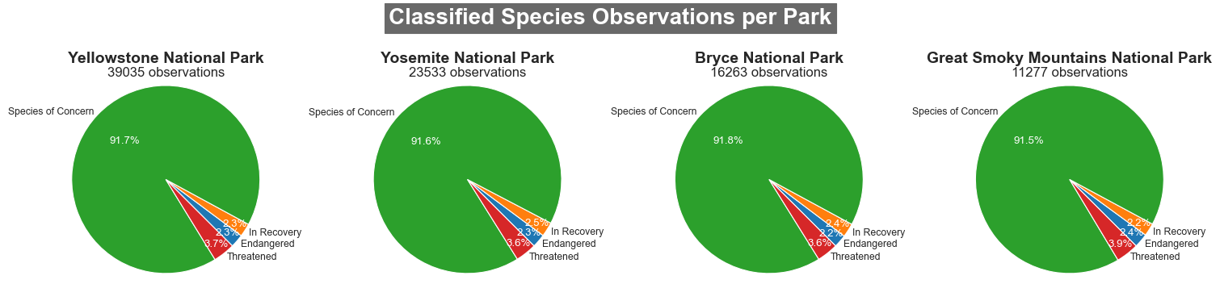
Data analysis
Confirming the similarity in the biodiversity of each park, they have the same distribution of endangered species observations.

Slide 21
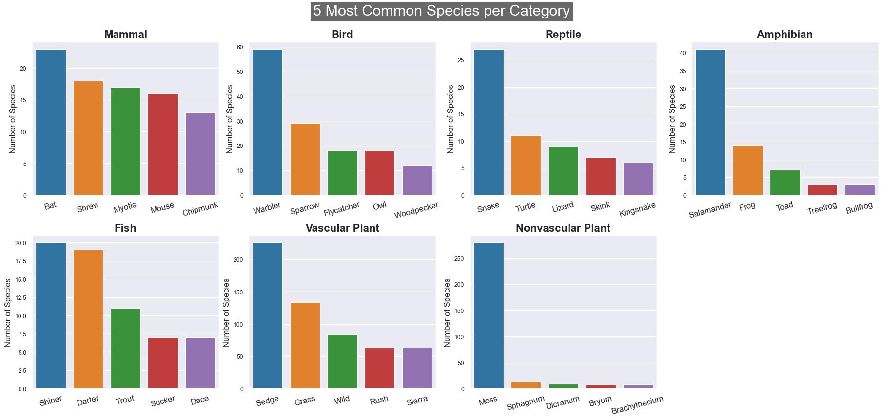
Data analysis
Entering the third, and final, part of this Exploratory Data Analysis, I decided to use their common names to aggregate different species into more commonly known groups for a better understanding of the data. Here we have the 5 most common groups of species per category and the number of species represented by each group.

Slide 22
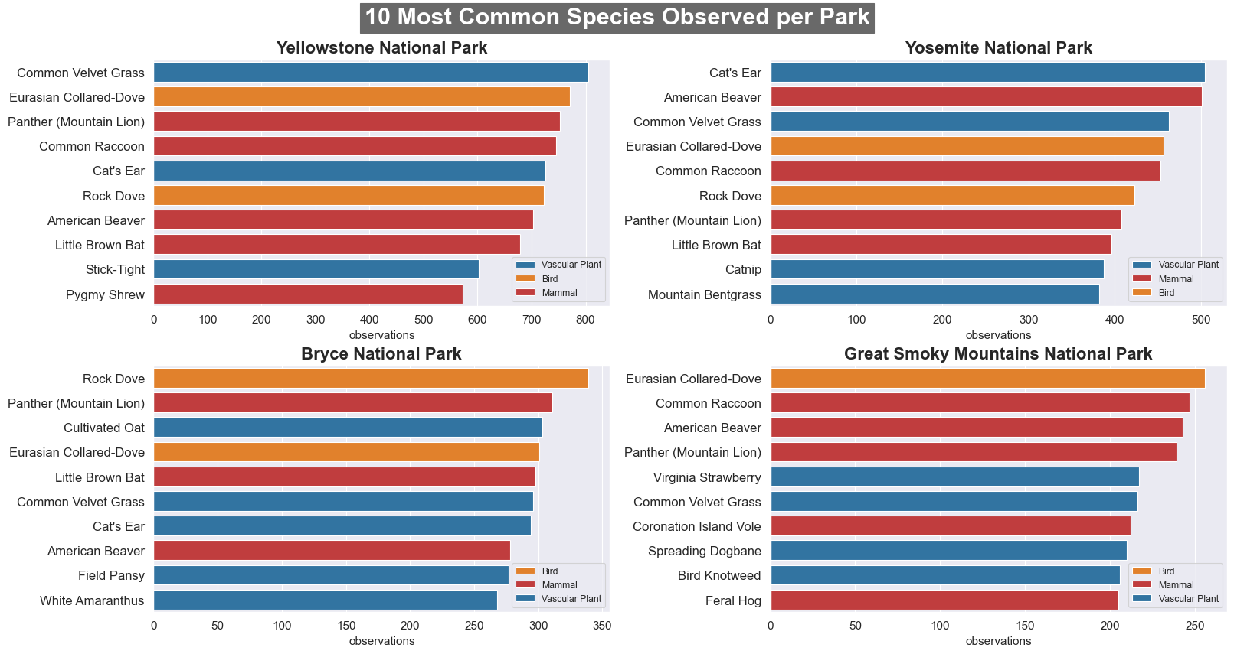
Data analysis
And finally, on this last plot, we have the 10 most observed species per park, represented by their common names. As we can see, most of the species are repeated over the parks.

Slide 23
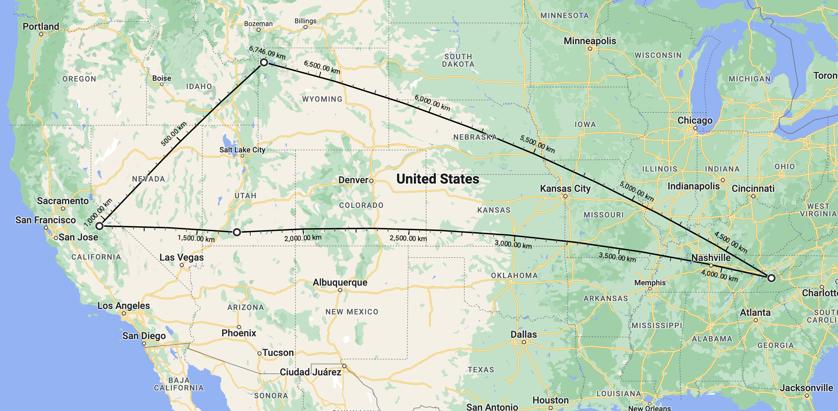
conclusions
As seen during this analysis, the biodiversity among those 4 National Parks is very similar, despite their distance (as shown in the image below) and the number of observations reported for each one.
Yellowstone
Yosemite
Bryce
Great Smoky
Mountains

Slide 24
conclusions
The total proportion of endangered species in the data set is not very alarming, since it’s close to 3% of the whole data, but when considering each category separately there are some numbers that call attention:
Vascular Plants represent ¾ of reported species, are the most commonly observed per park, and are the less endangered category.
Birds and Mammals have more than 15% of their species classified as in danger.
Fishes represent 40% of threatened species, and there are no species of fish in recovery.
Only 4 species are in recovery, representing 2% of the total endangered species.

